Slide 1
Visitors Digital Interaction - Case study

Slide 2
Introduction
ADP website visitors digital interaction
EDA
Outlier detection
Propensity model to predict if visitors submit lead form

Slide 3
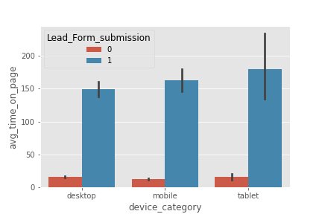
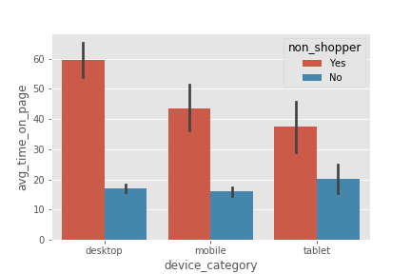
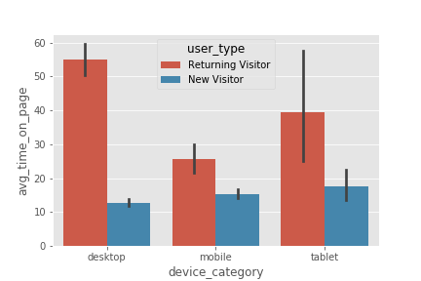
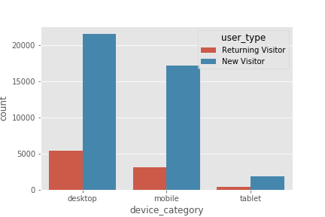
EDA

Slide 4
Outlier/Anomaly Detection
Used PyOD python library
Anomaly from multivariate data
Reduced Dimension( PCA, Embedding) and Clustering
Cluster-based Local Outlier Factor (CBLOF)-
score is computed by the distance of each instance to its cluster center multiplied by the instances belonging to its cluster
Histogram based outlier detector (HBOS)-
In multivariate anomaly detection, a histogram for each single feature can be computed, scored individually and combined at the end
Isolation Forest -
Forest is an unsupervised learning algorithm that belongs to the ensemble decision trees family. It explicitly isolates anomalies instead of profiling and constructing normal points and regions by assigning a score to each data point
KNN -
KNN is one of the simplest methods in anomaly detection. For a data point, its distance to its kth nearest neighbor could be viewed as the outlier score
Created flag for outliers
Useful to detect friction on the page visits
Future scope -
Deep learning base embedding techniques to create lower dimension representation and then use clustering too identify Outliers

Slide 5
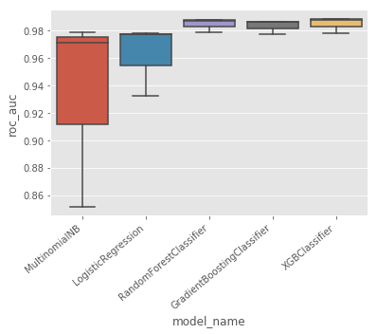
Propensity to predict visitors submit the form
Machine learning approach to built propensity models to predict visitors who submit the forms
Train model on 80% data and test on remaining data set
Built different classification models - Logistic regression, Multinomial classification, Random Forest, GBM and XGB

Slide 6
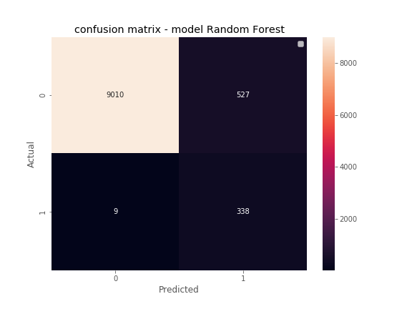
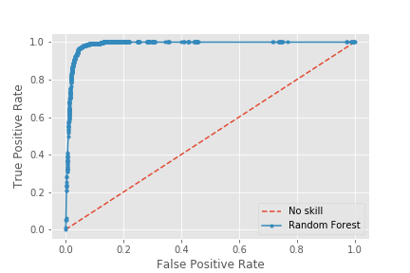
Propensity to predict visitors submit the form
Compared the models ROC-AUC and finalized Random forest as final result.
Achieved ROC-AUC =0.98 using Random Forest
Grid search for parameter tunings
Model stacking for better performance if time permits

Slide 7
Thank you

